Slide 1
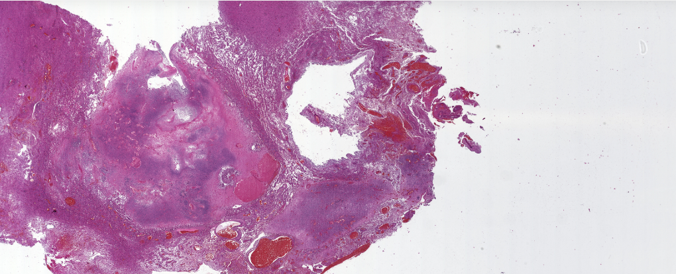
Internship: Digital Pathology Annotation Server
Yujung Lin

Slide 2
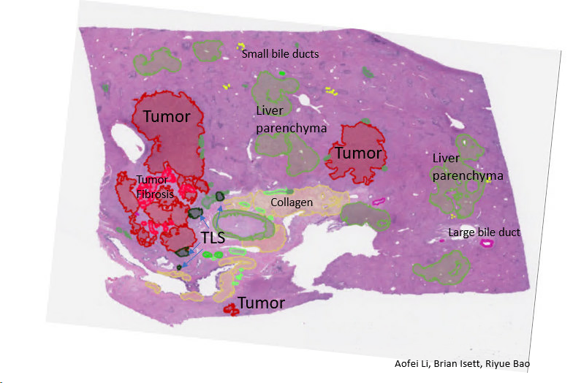
Introduction
Tumor samples are collected routinely at hospital
They are great resources for developing AI-based disease detection tool
Accurate classification of tumor vs. non-tumor region is a challenge
A digital platform that allows expert pathologists to annotate slides online
OMERO
Notes:
Motivation: tumor tissue slides are not fully utilized. Annotated slides are great resource for many things such as generate a consensus annotations and be used as the training data for machine learning to develop a tumor classifier.
To achieve this, expert pathologists are needed. We also need to have a platform where they can annotation the images.

Slide 3
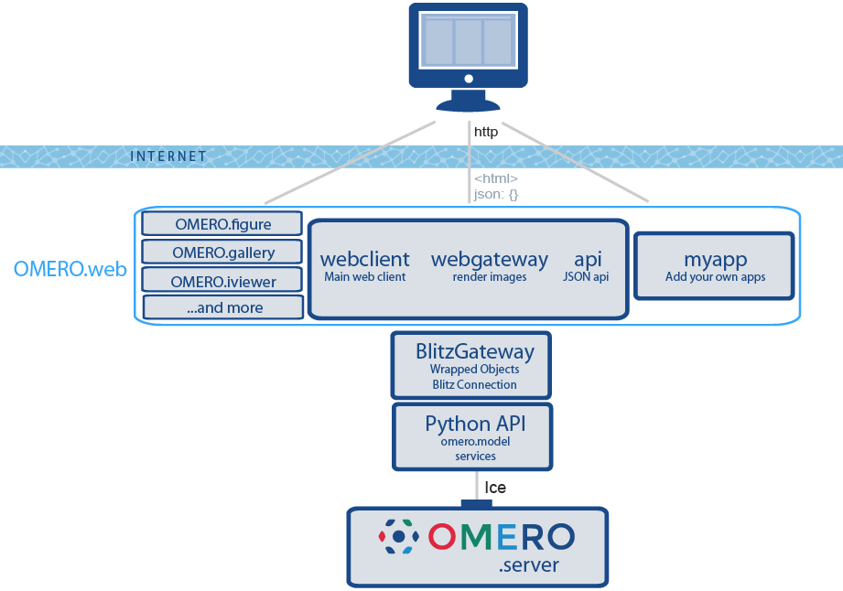
Background
Notes:
OMERO: free, open source, easy to deploy on many OS systems
It has a dashboard style user interface that is easy to navigate.
It can also be integrated into one’s own application.
Users can interact with OMERO server in many ways such as OMERO.insight, which is a local app, and OMERO.web, which is a web portal

Slide 4
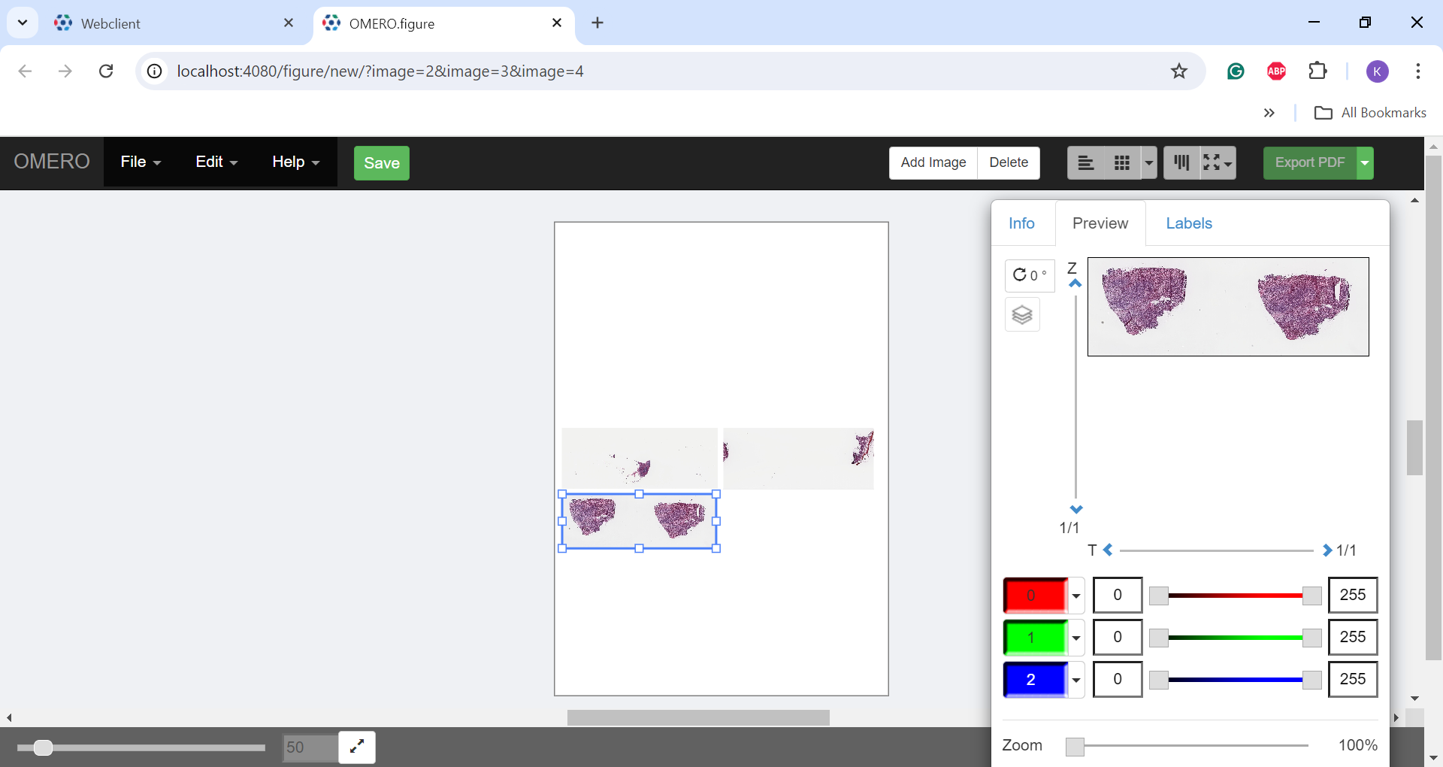
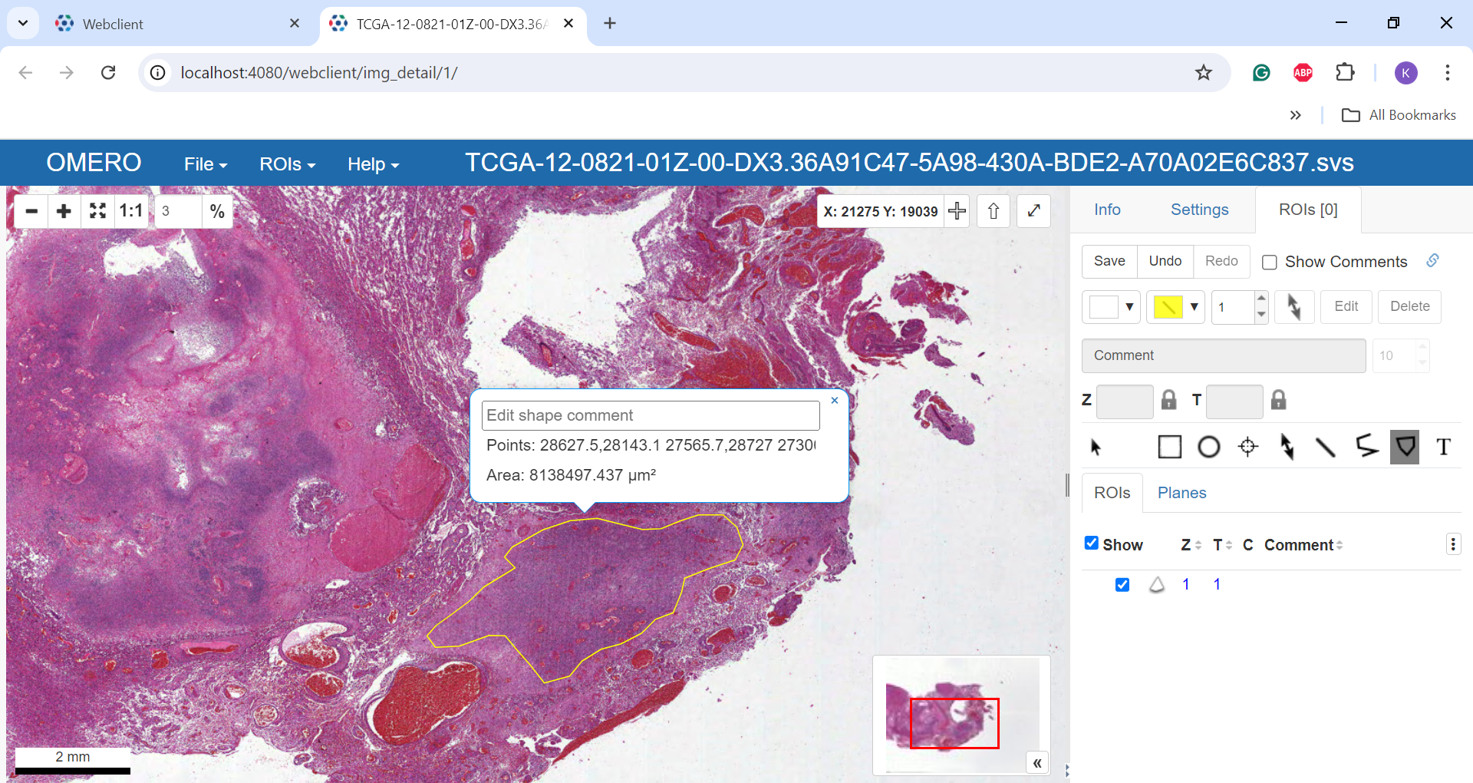
OMERO
Many powerful features
Storage
Creating figures
OMERO.figures
Annotation
OMERO.iviewer
Extensions
QuPath, ImageJ, OpenCV…
Notes:
OMERO has a lot of features that allow users to use them in various ways.
It can be used as a online storage to organize image data.
OMERO.figure can generate figures for publications
OMERO.iviewer allows users to annotate slides online without downloading large amounts of data to their local machine.
Other extension such as ImageJ and QuPath also provide powerful features for users to analyze images.

Slide 5
Approach
Two deploy options:
Manually install using command line
Needs to install OMERO Server, Web, and CLI separately
Install using Docker Compose
Easier
Do not have to configure the local system
Notes:
2 options: manual installation and docker compose
Why is docker compose better:
Manual installation using command line needs to be adjust according to the local OS systems. Since the commands are different for each OS systems, it is hard to quickly find the cause of an error during installation.
Also, server, web, and CLI need to be install separately using command line installation
Docker:
Since the Omero images are provided by the official, we do not need to configure the base OS system
Therefore, docker compose is a better way to deploy an OMERO server

Slide 6
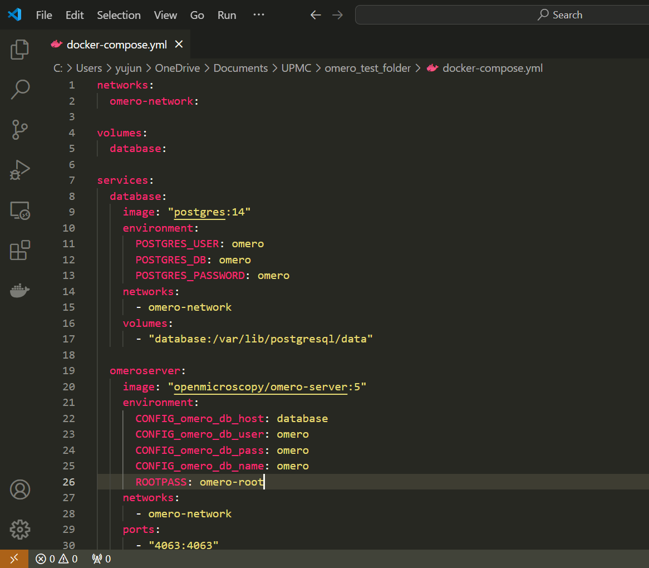
Docker Compose
Install Docker Desktop
Create Docker Compose file
There should only be one docker-compose.yml in a folder
Declare volume, network, and services
Pull and start running the server!
Notes:
Install Docker Desktop so docker engine is available
Create a docker-compose yaml file
Declare network, volume (data storage), and services (base images)
Under services, users will list out the images needed to run an application.
For OMERO, omero-server, omero-webstandalone, and postgresql are needed
It is better to indicate a specific version of images so there will not be any version conflict if a newer version image is published
Configurations are listed as environment variable under each service
After the yaml file is completed, run docker compose pull and docker compose up –d to spin up the server

Slide 7
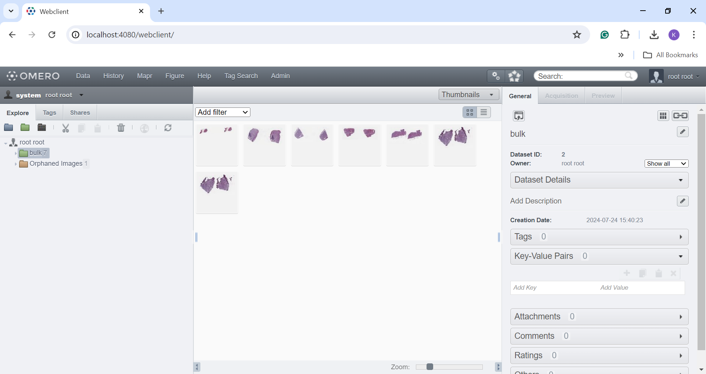
Result
Connect to OMERO server via Web client, ImageJ, and QuPath
Import images as single file or bulk via CLI
Iviewer
annotate image online
QuPath
annotate image and export rendered images and ROI information
Notes:
Connect to server through webclient
Import images in command line
Connect to Qupath
Export images in qupath using scripts
Maybe a speed up video

Slide 8
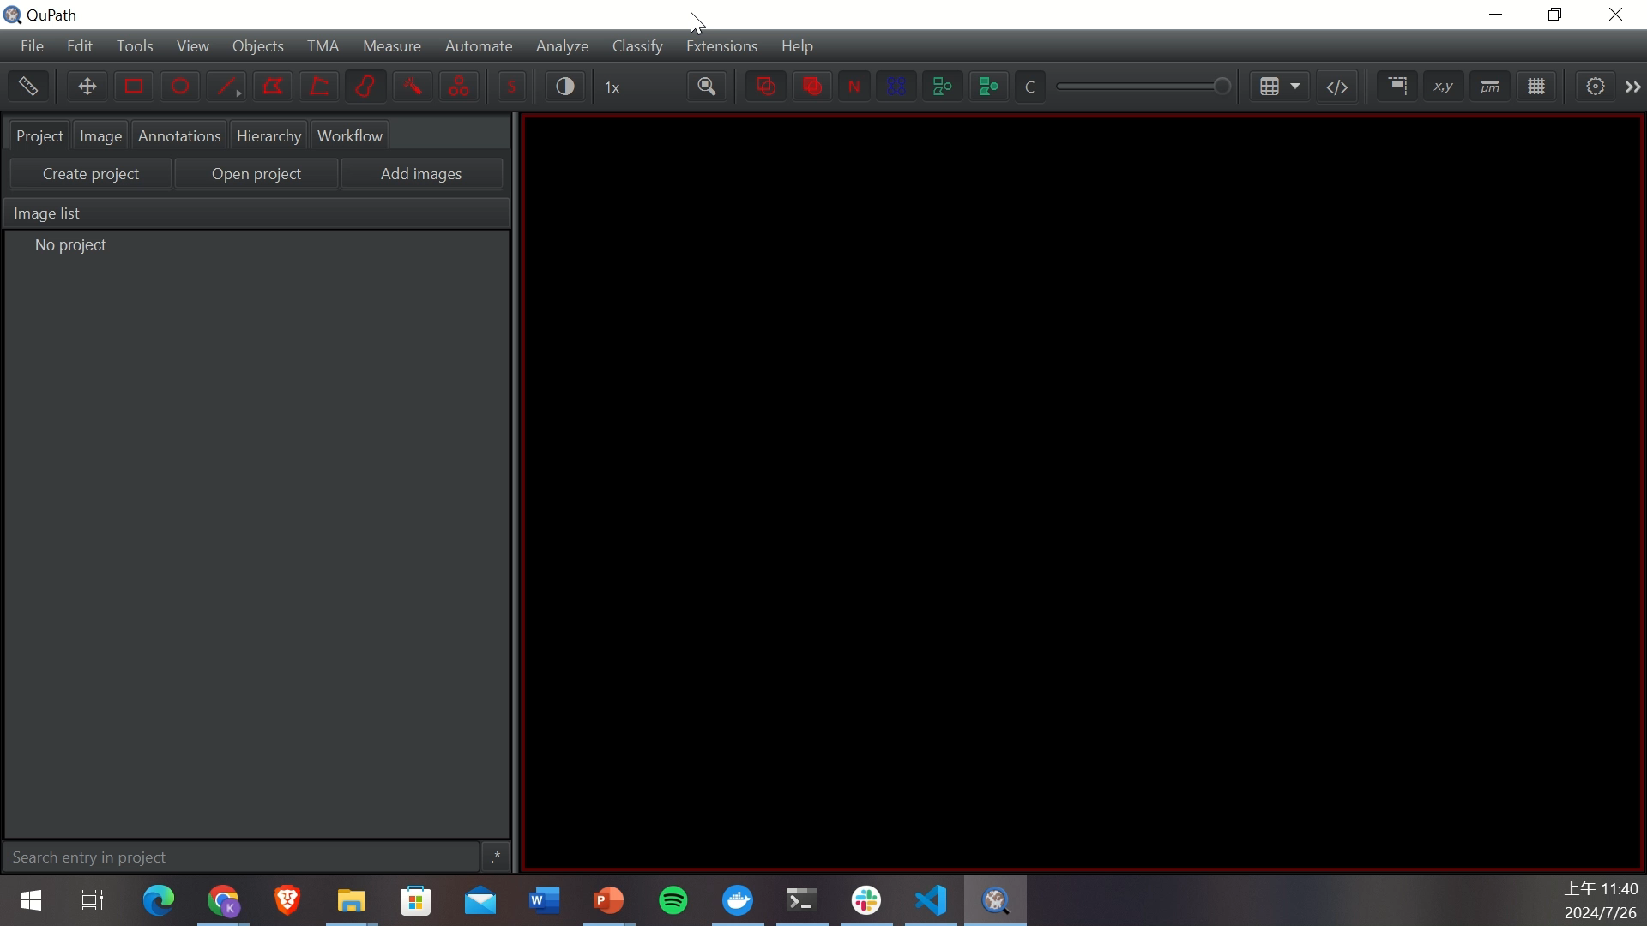
Connect QuPath to OMERO server
Notes:
The video demonstrates how to connect QuPath to omero and access the data

Slide 9
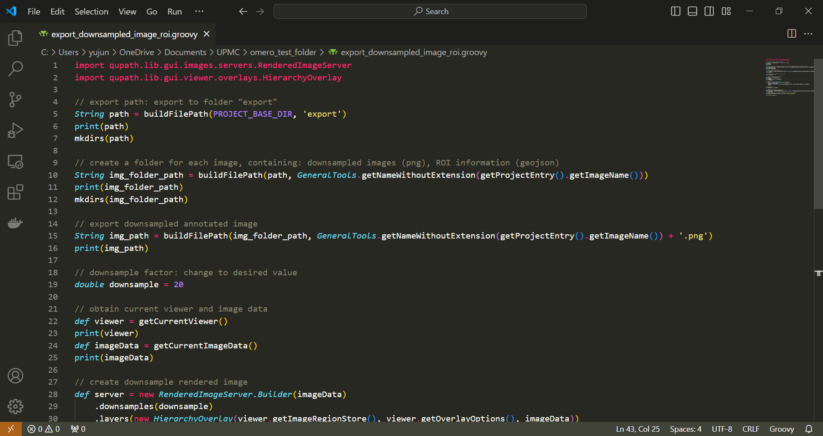
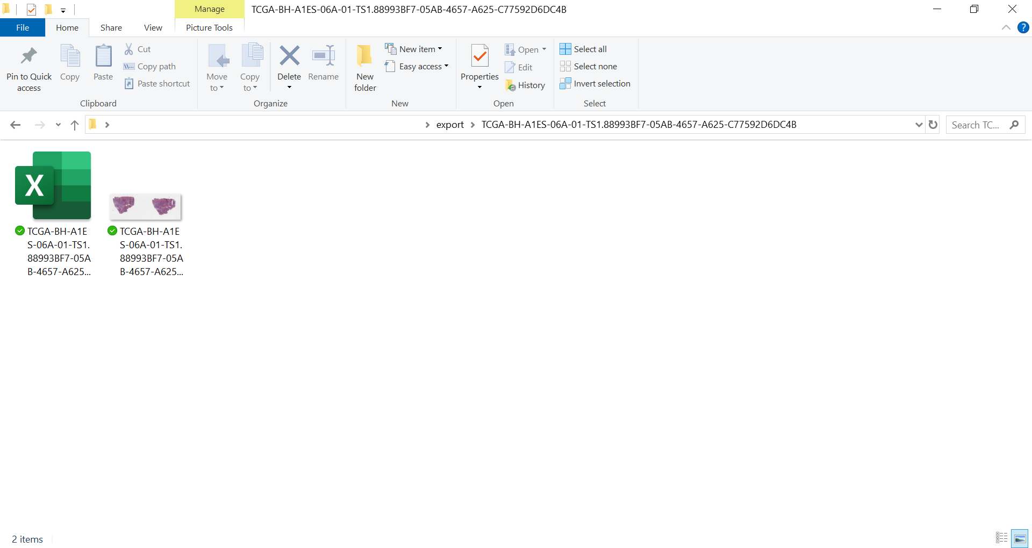
Export Images using QuPath
There are two options to export images via QuPath:
Export features
Export tiled images as OME-TIF, rendered SVG, snap shots, and ROI information
Export script
Export everything at once
File organized in separate folders for each image
Notes:
QuPath export features can export tiled images as OME-TIF and rendered SVG. It can also export the current viewer as snap shot. There is also features to export ROI information. However, it cannot export all these at once. If you want to export information for the whole project, you will have to run the export for each image separately. Thus, using a script to export images is the best option since you can run the script on the entire project.

Slide 10
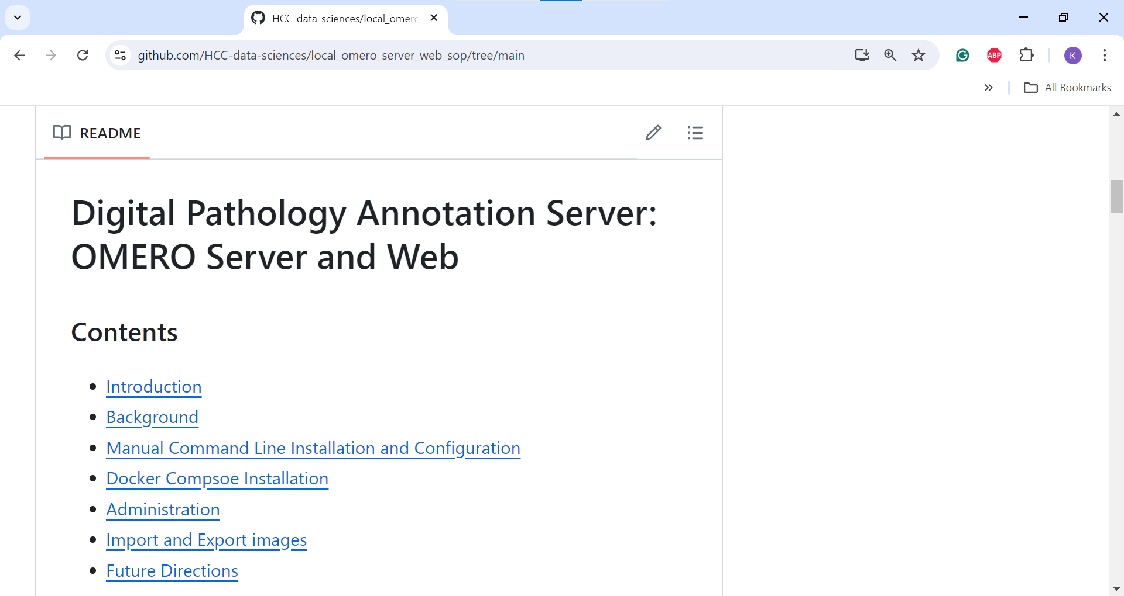
Installation SOP on Github repo

Slide 11
Docker on AWS EC2 instance
Instruction on deploying OMERO on AWS:
https://github.com/aws-samples/digital-pathology-on-aws?tab=readme-ov-file#omero-insight-on-appstream
Install using Docker or Docker Compose
I was about to use docker compose to install the server
Port forwarding: create port tunnel between local machine and AWS
Another way to connect: OMERO.insight via Amazon AppStream 2.0
Requires S3 permission

Slide 12
Conclusions and Future Directions
OMERO is a server that allows expert pathologists to access large amounts of tissue slides
Annotated slides can generate a consensus annotations
They can also be used as training data to develop an accurate tumor classifier
Deploy on cloud computing service such as AWS
Host a larger server
Scalable and secure storage
Accessible to pathologists outside of UPMC network
Notes:
Cloud computing
AWS
Larger scale server that is accessible to pathologists outside of UPMC network

Slide 13
Acknowledgments
OMERO developers, Open Microscopy Environment (OME). OMERO: Flexible, model-driven data management software for microscopy images. URL: http://openmicroscopy.org/omero
OMERO developers, Open Microscopy Environment (OME). OMERO Docker example: Flexible deployment for microscopy image management. URL: https://github.com/ome/docker-example-omero
AWS Developers, Amazon Web Services (AWS). Digital Pathology on AWS: Cloud-based solutions for pathology image analysis. URL: https://github.com/aws-samples/digital-pathology-on-aws

